Slide 1
Project conducted on
ASD DATA DRIVEN ANALYTICS

Slide 2

Project Overview
Title : ASD DATA DRIVEN ANALYTICS
Autism Spectrum Disorder (ASD) Data-Driven Analysis aims to derive actionable insights from video analytics data collected during the capture of videos. The project focuses on maximizing the effective utilization of data to better understand and support individuals with ASD. The primary objective is to maximize the effective utilization of this data, ensuring actionable insights to minimize adverse effects of specific behaviours.
Start date: 01/01/2024
End date: 30/01/2024
Organization : 360digitmg
Prepared and presented by: Athulya P
https://www.linkedin.com/in/athulya-ramesan-56693725a

Slide 3

Project Leadership
Bharani Kumar Depuru
Director and Co-Founder at Innodatatics
linkedin.com/in/bharanikumardepuru

Slide 4

Contents
Project Architecture
Business problem
Business objective, constraints and success criteria
Technical stacks
Data collection and details
Exploratory Data Analysis
Visualization
Insights
Challenges
Future scopes
Notes:
Change

Slide 5
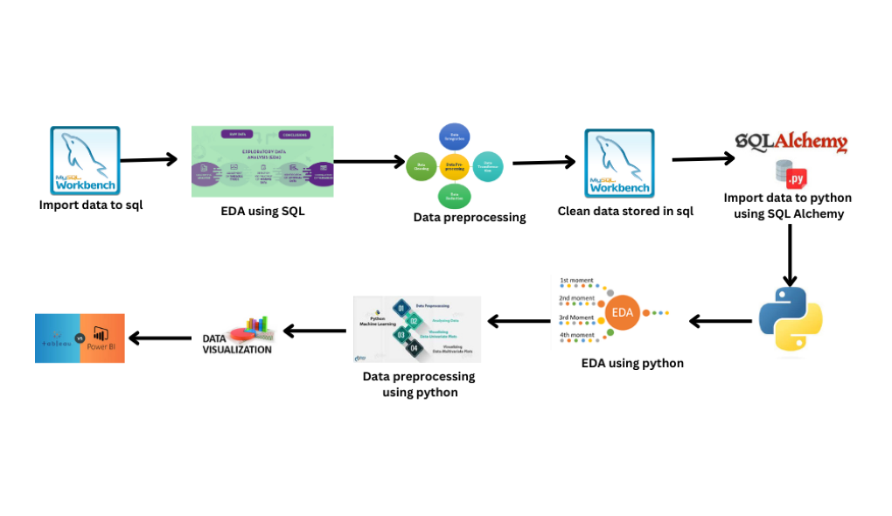
PROJECT ARCHITECTURE

Slide 6
Business Problem
While videos are captured what kind of insights and dashboards can be generated using the data extracted from video analytics is still unclear.
Maximize the effective utilization of data
Business objectives
Business Constraints
Minimize the usage of manual creation of reports.
Business Success Criteria
Economic Success Criteria
Success Criteria
Actionable insights should increase to atleast 90%
By providing timely intervention, the adverse effects of a specific behaviour exhibited can be avoided.

Slide 7
CRISP-ML(Q) Methodology
There are six stages of CRISP-ML(Q) Methodology
1.Business and data understanding
2.Data preparation
3.model building
4.Model evaluation
5.Model deployment
6.Monitoring and maintenance

Slide 8



Technical Stacks

Slide 9
Data Collection and Understanding
Dataset 1 captures video analytics related to ASD behaviors. Dataset 2 provides video details such as ID, name, and length. Data Quality and Preprocessing: Briefly discuss the steps taken to ensure data quality, handle missing values, outliers, and preprocess the datasets for analysis.

Slide 10
Exploratory Data Analysis [EDA]
Exploratory Data Analysis (EDA) is an analysis approach that identifies general patterns in the data . These patterns include outliers and features of the data that might be unexpected. EDA is an important first step in any data analysis.
Notes:
EDA is used for seeing what the data can tell us before the modeling task.
Change

Slide 11
EDA
Name of dataset: data
Count of rows: 28189
 | FIRST BUSINESS MOMENTS |  |  | SECOND BUSINESS MOMENTS |  |  | THIRD BUSINESS MOMENT | FOURTH BUSINESS MOMENT
 | Mean | Median | Mode | Std dev | Variance | Range | Skewness | Kurtosis
duration | 41.69775551 | 33.13 | 1.2 | 33.42819449 | 1117.44419 | 129.18 | 0.69935737 | 2.325016228
asd_project34_video_id | 20.03543936 | 15 | 39 | 14.45336398 | 208.8997302 | 38 | 0.370612332 | 1.482834768
probability | 0.9206 | 0.9919778 | 1 | 0.1394956 | 0.019459 | 0.446225169 | 296.05035 | 2034.268
fps | 23.26283029 | 29.769 | 12.496133 | 8.043261229 | 64.6940512 | 17.548307 | -0.515791192 | 1.375670608
Name of dataset: Video_details
Count of rows: 41
 | STATISTICAL INSIGHTS
 | EDA after preprocessing
 | Length
Mean | 24.3902
Median | 14
Mode | 11
Variance | 412.2867
STD dev | 20.3048

Slide 12
Inferences from EDA
First Business Moment: The mean, median and mode values ae determined for each variables which gives an idea about the average value and most frequently occurred values for each.
Second Business Moment: Variance, standard deviation and range will give an idea about the spread of the data
If the variance and standard deviation is near zero, which indicates that there is not that much difference between the points from the mean value. Ie, spread is less
If the standard deviation and variance shows really large value which indicates the spread of the data in really large or fatter distribution
Third Business Moment: the skewness is near zero which implies it is almost normal distribution.
Fourth Business Moment: really big kurtosis values which indicates the really sharp peak.

Slide 13
Data preprocessing
Duplicates:
No Duplicate records from the data
Missing values:
There is no missing values in two data sets
Outliers:
In the probability column 3282 outliers detected
No other columns has the presence of outliers
Maximum outliers are replaced with 95th percentile and minimum outliers are replaced by 5th percentile
Using winsorization method by applying filter probability < 0.68

Slide 14
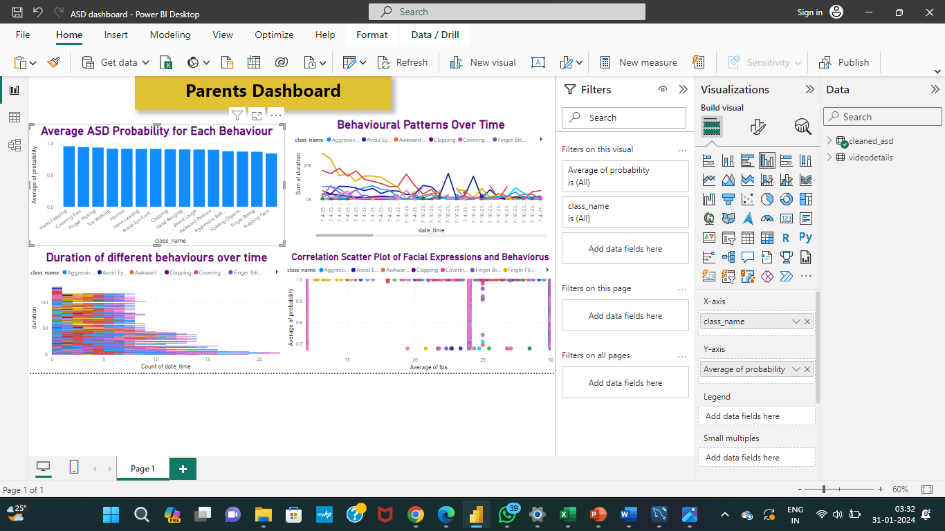
Data Visualization
Notes:
Add graphical

Slide 15
Future Scopes
Advanced Predictive Analytics:
Develop predictive models to anticipate future behavioral patterns based on historical data.
Real-time Monitoring:
Implement real-time monitoring capabilities for immediate intervention.
Integration with External Data:
Explore integrating external data sources for a holistic understanding of ASD-related behaviors
Enhanced User Interaction:
Develop interactive dashboards for more user engagement and customized insights.
Longitudinal Analysis:
Conduct longitudinal analysis to track behavioral changes over extended periods.
Collaboration with Experts:
Collaborate with ASD experts to refine analytics models and enrich insights.
Automated Reporting:
Develop automated reporting tools to meet business constraints and save time.

Slide 16
Business insights
Behavioral Patterns Identification:
Identification of key behavioral patterns in individuals with ASD, aiding caregivers and parents in understanding and managing their child's behavior effectively.
Early Signs Detection:
Early identification of potential signs of ASD through video analytics, enabling timely interventions and support for future autists.
Scientific Understanding Enhancement:
Contribution to scientific understanding of ASD through the analysis of video analytics data, facilitating research and academic studies in the field.
Personalized Interventions:
Development of personalized interventions based on individual behavioral patterns, optimizing support strategies for individuals with ASD.
Dashboard Accessibility:
Creation of user-friendly visualization dashboards accessible to caregivers, parents, future autists, and researchers, promoting widespread use and understanding of the data.

Slide 17
Challenges
Handling and analyzing large volumes of data might become a challenge.
While treated in sql there is a presence of outliers in the probability column which is then treated connecting in python.
Overcoming challenges in integrating data from different sources, particularly when dealing with multiple datasets

Slide 18

Queries ?

Slide 19


